Slide 1
ToDo List System
A site made by Valentin, Georgi Popov, Alexander Semerjiev and Darin Kolev

Slide 2
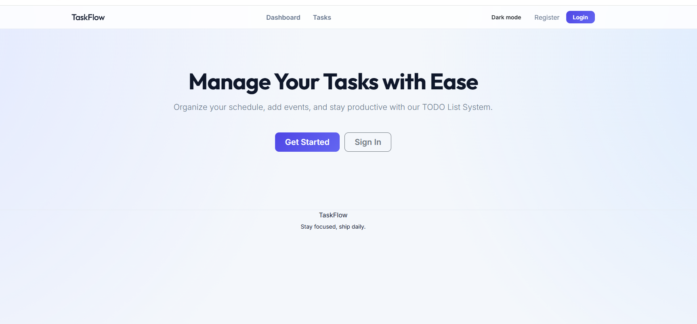
What is it?
The ToDo List site is a system handfully crafted to allow the creation and management of tasks by logged users.

Slide 3
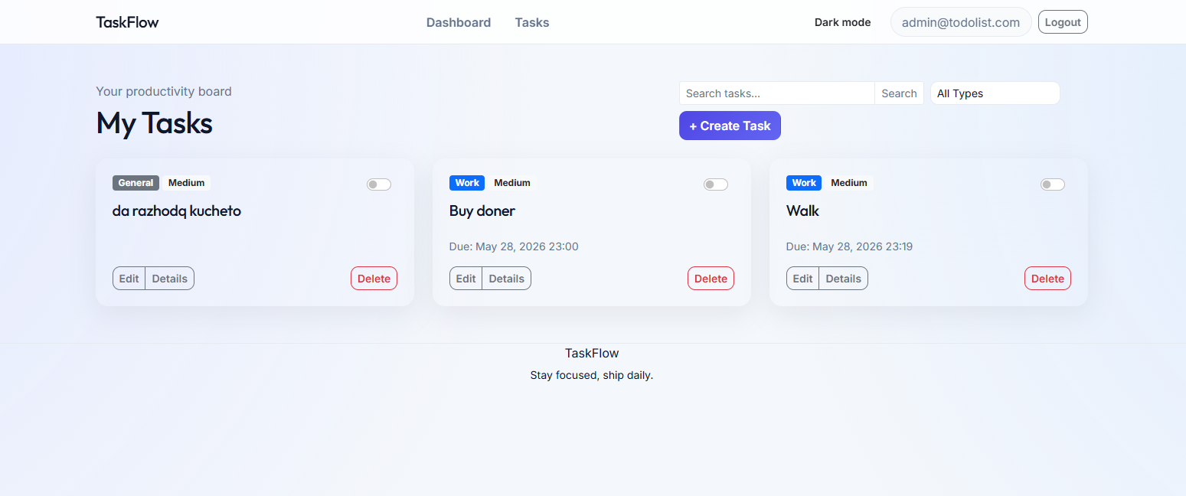
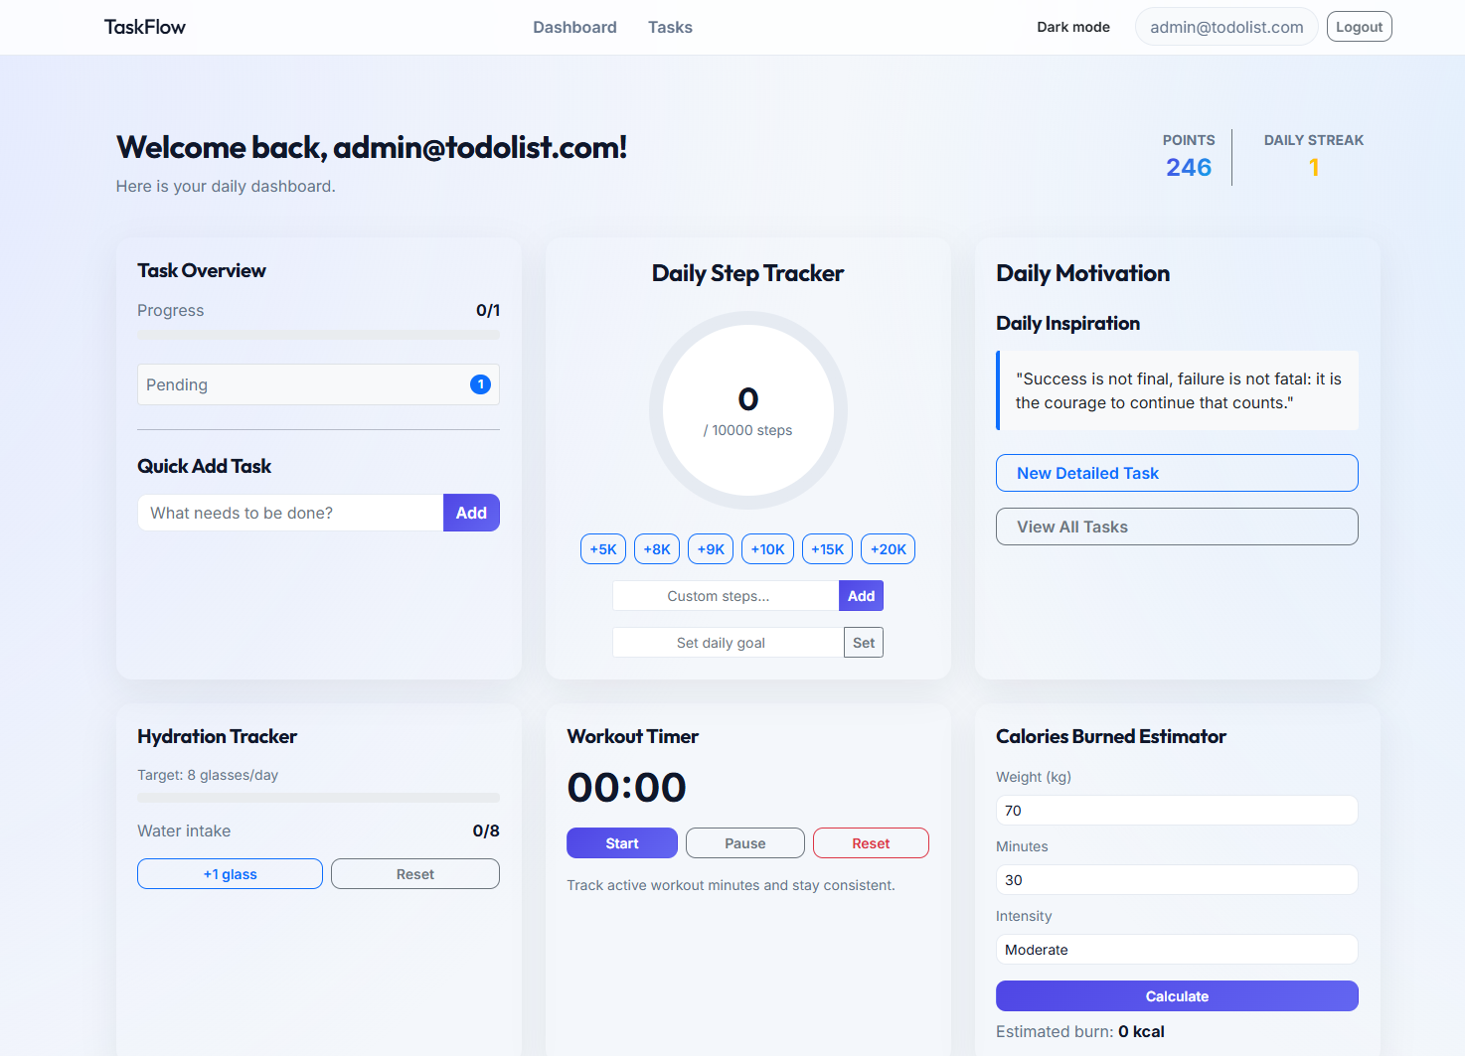
Features:
Task creation:
Editing, deleting, reviewing and creating toggleable notes connected to User Ids
Daily dashboard:
Includes working quick tasks, timer, pedometer, hydration tracker and more
2

Slide 4
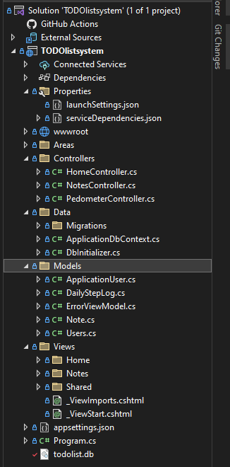
The backend
The backend is structured alike an MVC model, possessing separate sections for the system’s views, models, controllers and database.
Models initialize the data, drawing information from the database + user info. The controller handles the functionalities and sends it all to what we see – the view.

Slide 5
Thanks for watching

